Slide 1
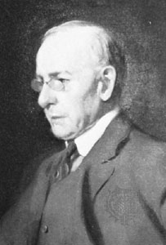
LOUIS HENDRY SULLIVAN

Slide 2
LOUIS HENDRY SULLIVAN
Louis Henry Sullivan was an American architect, and has been called the "father of skyscrapers" and "father of modernism".
Born: September 3, 1856, Boston, Massachusetts, United States
Died: April 14, 1924, Chicago, Illinois, United States
Buried: Graceland Cemetery, Chicago, Illinois, United States
Books: The Autobiography of an Idea, The Public Papers, Kindergarten Chats and Other Writings
Education: English High School of Boston, Massachusetts Institute of Technology
He posthumously received the AIA Gold Medal in 1944.

Slide 3
BUILDINGS
AUDITORIUM BUILDING(CHICAGO)
WAIN WRIGHT BUILDING
CARSON;PIRIE,SCOOT AND COMPANY BUILDING
PRUDENTIAL BUILDING
BAYARD CONDICT BUILDING
KRAUSE MUSIC STORE(CHICAGO)
PILGRIM BAPTIST CHURCH

Slide 4
DEXTAR BUILDING
FARMERS AND MERCHANTS UNION BUILDING
HOLY TRINITY ORTHODOX CATHEDRAL
VAN ALLEN BUILDING
HOME BUILDING ASSOSIATION BUILDING
PURDE STATE BANK

Slide 5
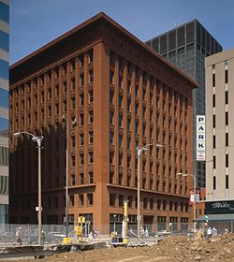
WAIN WRIGHT BUILDING

Slide 6
WAINWRIGHT BUILDING
The Wainwright Building (also known as the Wainwright State Office Building) is a 10-story red brick office building.
The Wainwright Building is among thefirst skyscrapers in the world.
It was designed by Dankmar Adler and Louis Sullivan in the Palazzo style .
It is described as "a high influential prototype of the modern office building" by the National Register of Historic Places
Wainwright Building "the very first human expression of a tall steel office-building as Architecture

Slide 7
It Architect Frank Lloyd Wright called the Wainwright Building "the very first human expression of a tall steel office-building as Architecture.it built between 1890 and 1891
He is a “father of skyscraper”

Slide 8
Upon its initial completion, the Wainwright Building was "popular with the people" and received "favorably" by critics
In 1968, the building was designated as a National Historic Landmar and in 1972 it was named a city landmark.

Slide 9
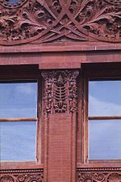
Despite the classical column concept, the building's design was deliberately modern, featuring none of the neoclassical style that Sullivan held in contempt.
The piers read as pillars
Historian Carl W. Condit described the Wainwright as "a building with a strong, vigorously articulated base supporting a screen that constitutes a vivid image of powerful upward movement."^{[12]} The base contained retail stores that required wide glazed openings; Sullivan's ornament made the supporting piers read as pillars. Above it the semi-public nature of offices up a single flight of stairs are expressed as broad windows in the curtain wall. A cornice separates the second floor from the grid of identical windows of the screen wall, where each window is "a cell in a honeycomb.The building's windows and horizontals were inset slightly behind columns and piers, as part of a “vertical aesthetic” to create what Sullivan called “a proud and soaring thing.This perception has since been criticized as the skyscraper were designed to make money, not to serve as a symbol.

Slide 10
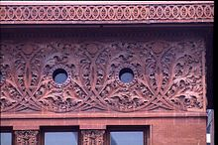
The intricate frieze along the top of the building along with the bull's-eye windows.
The ornamentation for the building includes a wide frieze below the deep cornice,which expresses the formalized yet naturalistic celery-leaf foliage typical of Sullivan and published in his System of Architectural Ornament, decorated spandrels between the windows on the different floors and an elaborate door surround at the main entrance. "Apart from the slender brick piers, the only solids of the wall surface are the spandrel panels between the windows..... They have rich decorative patterns in low relief, varying in design and scale with each story. The frieze is pierced by unobtrusive bull's-eye windows that light the top-story floor, originally containing water tanks and elevator machinery. The building includes embellishments of terra cotta.. a building material that was gaining popularity at the time of construction..

Slide 11
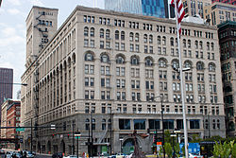
AUDITORIAM BUILDINGS

Slide 12
Built1889. ArchitectDankmar Adler; Louis Sullivan.
Architectural styleLate 19th and Early 20th Century American Movements
It was added to the National Register of Historic Places on April 17, 1970.It was declared a National Historic Landmark in 1975
The Auditorium Theatre is part of the Auditorium Building
Adler and Sullivan designed a tall structure with load-bearing outer walls, and based the exterior appearance partly on the design of H.H. Richardson's Marshall Field Warehouse, another Chicago landmark...The Auditorium is a heavy, impressive structure externally, and was more striking in its day when buildings of its scale were less common. When completed, it was the tallest building in the city and largest building in the United States.
One of the most innovative features of the building was its massive raft foundation, designed by Adler in conjunction with engineer Paul Mueller. The soil beneath the Auditorium consists of soft blue clay to a depth of over 100 feet, which made conventional foundations impossible. Adler and Mueller designed a floating mat of crisscrossed railroad ties, topped with a double layer of steel rails embedded in concrete, the whole assemblage coated with pitch.

Slide 13
Housed in the building around the central space were an 1890 addition of 136 offices and a 400-room hotel
In the center of the building was a 4,300 seat auditorium,

Slide 14
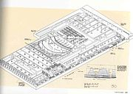

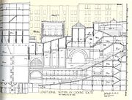
FOUNDATION
BASEMENT
INTERIOR OF BUILDING

Slide 15
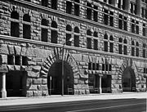
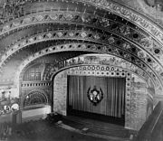
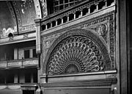
EXTERIOR DETAIL OF THE AUDITORIUM THEATER
INTERIOR DETAIL OF THE AUDITORIUM BALCONY
INTERIOR DETAIL OF THE AUDITORIUM THEATER

Slide 16
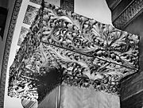
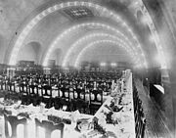
GRANZ HALL CAPITAL
AUDITORIUM HOTEL

Slide 17
THANK
YOU

